Slide 1

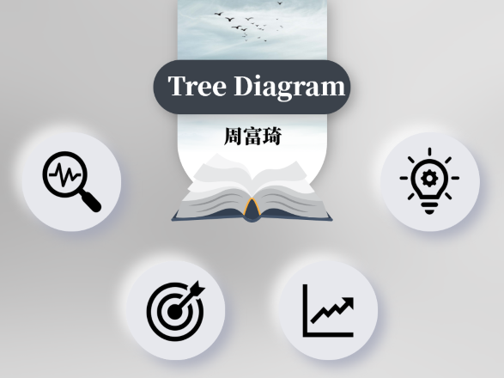

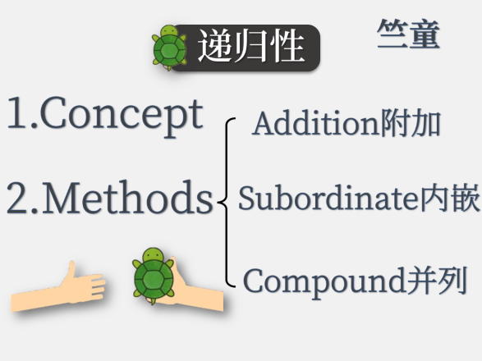



Slide 5



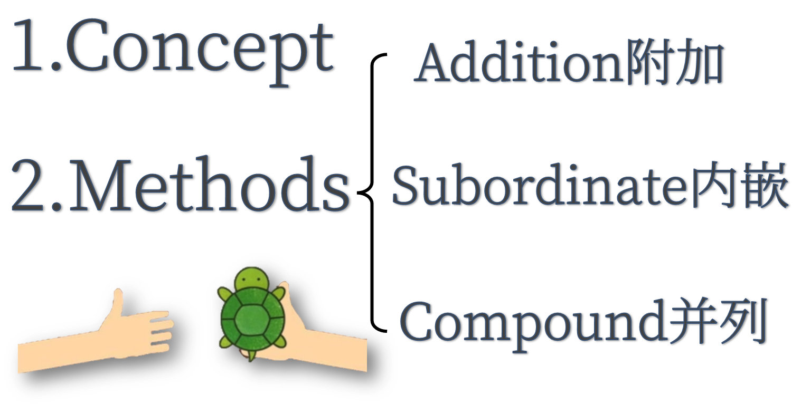

Slide 6




Slide 7

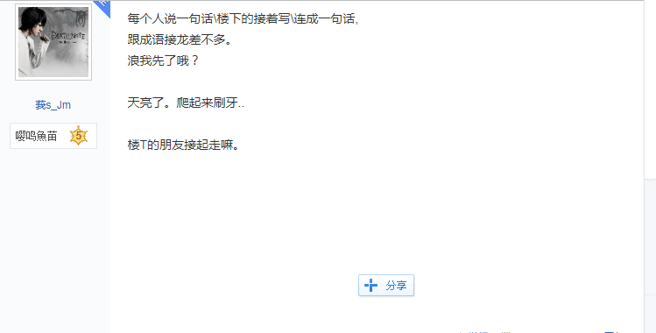
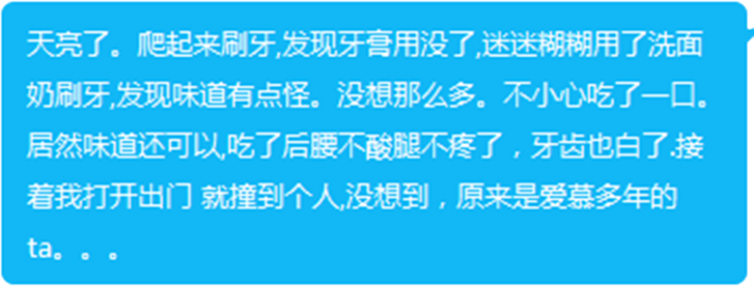




Slide 8




Methods
Addition
Methods
Subordinate
Compound

Slide 9

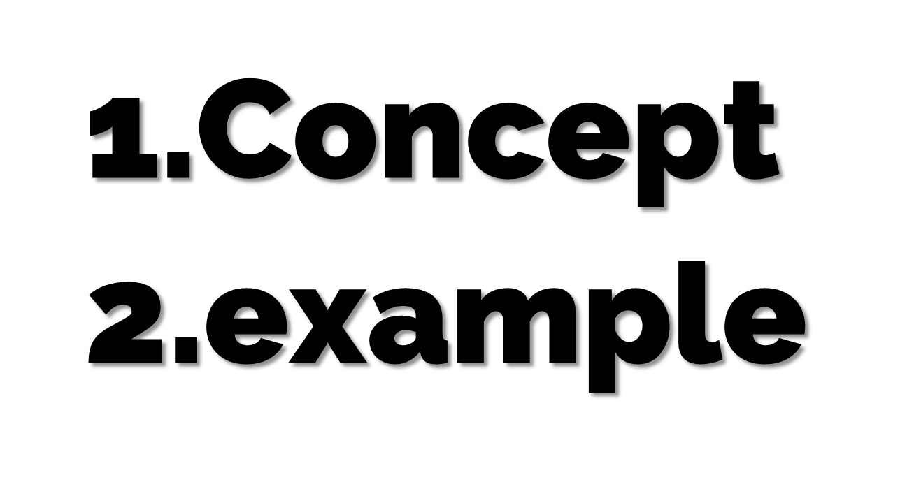
Addition

Slide 10
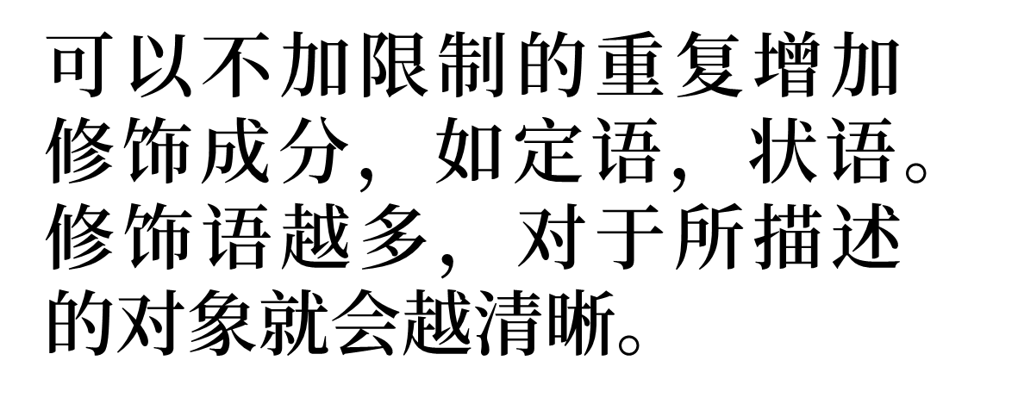
Addition
01
Concept

Slide 11
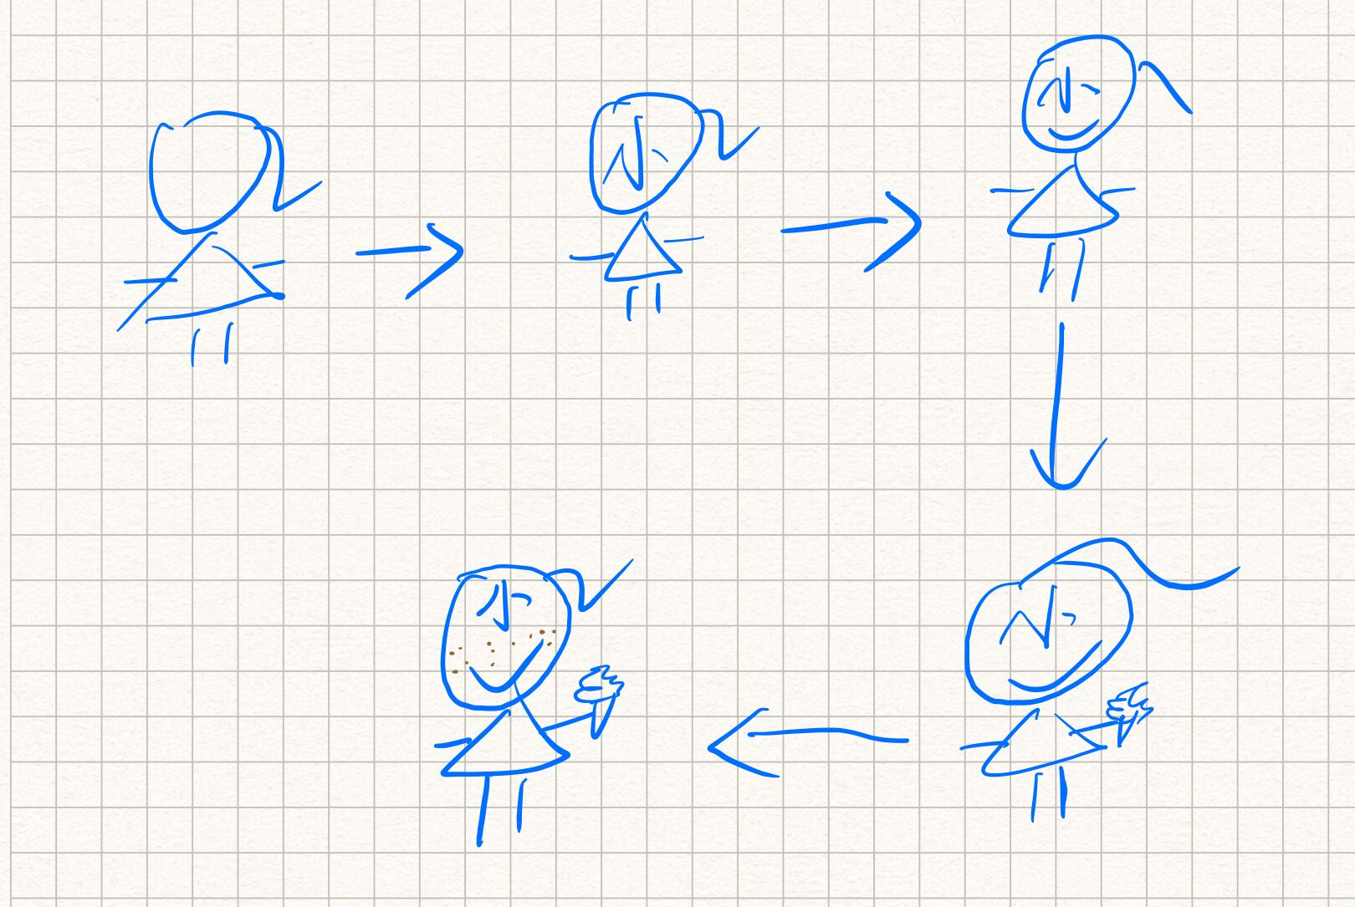
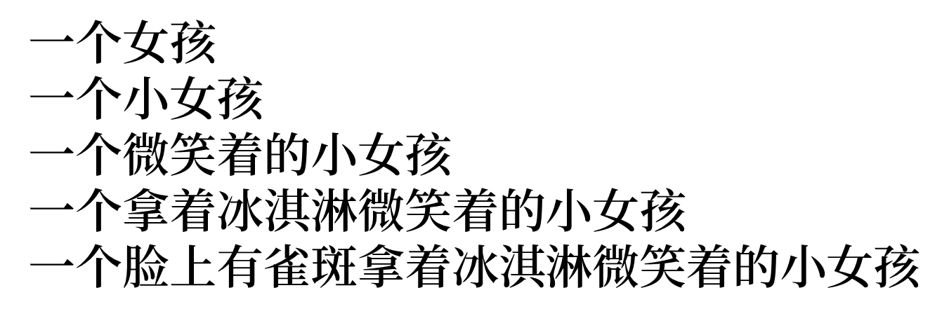
Addition
02
Examples

Slide 12



Subordinate

Slide 13
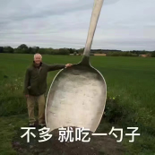
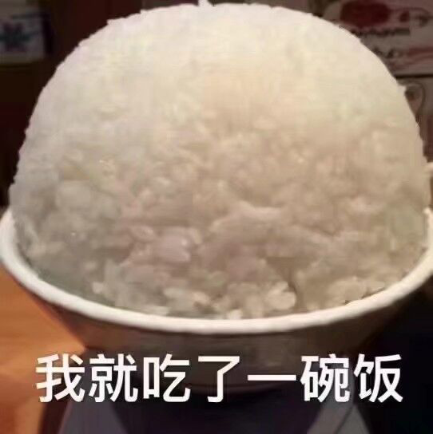
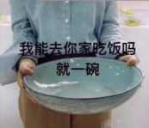
Subordinate
班长和我说他吃了五个馒头这件事让我很震惊以至于我也多吃了一碗米饭
班长和我说他吃了五个馒头这件事让我很震惊
班长和我说他吃了五个馒头
他吃了五个馒头

Slide 14
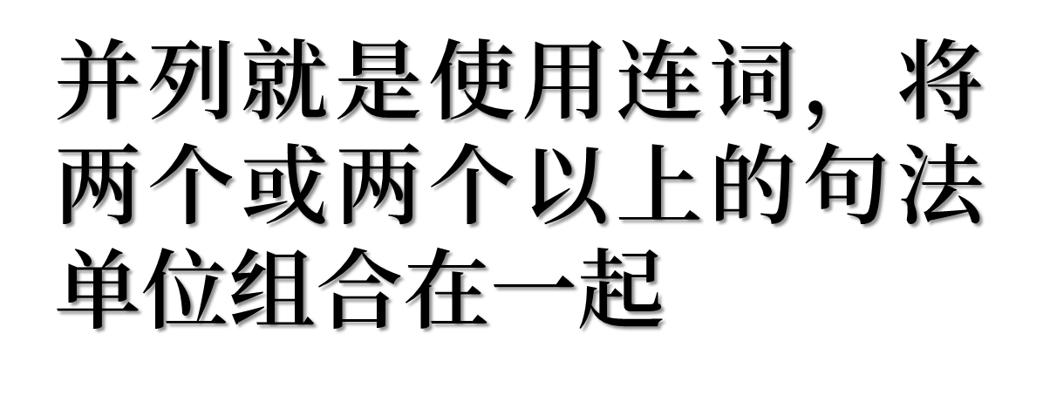

Compound

Slide 15

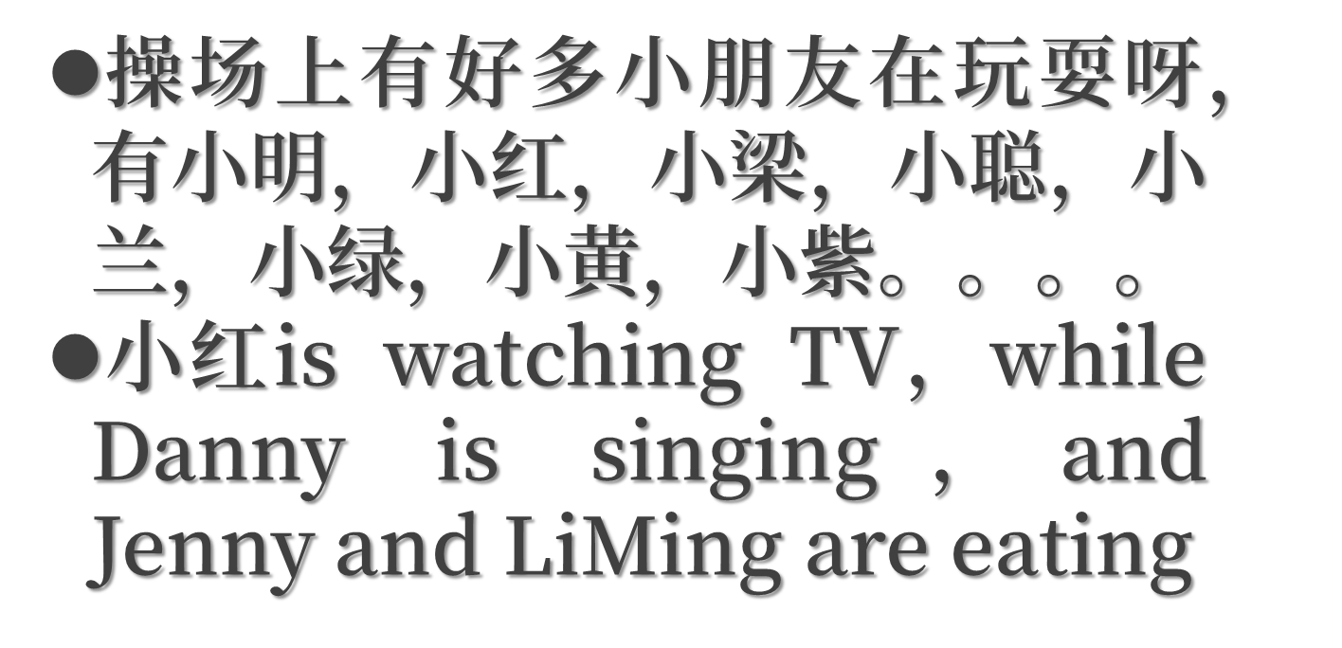
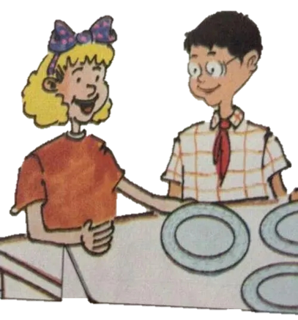
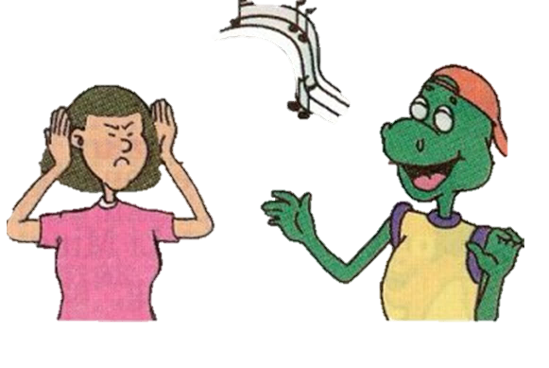
Compound

Slide 16

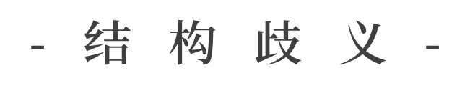


Slide 17
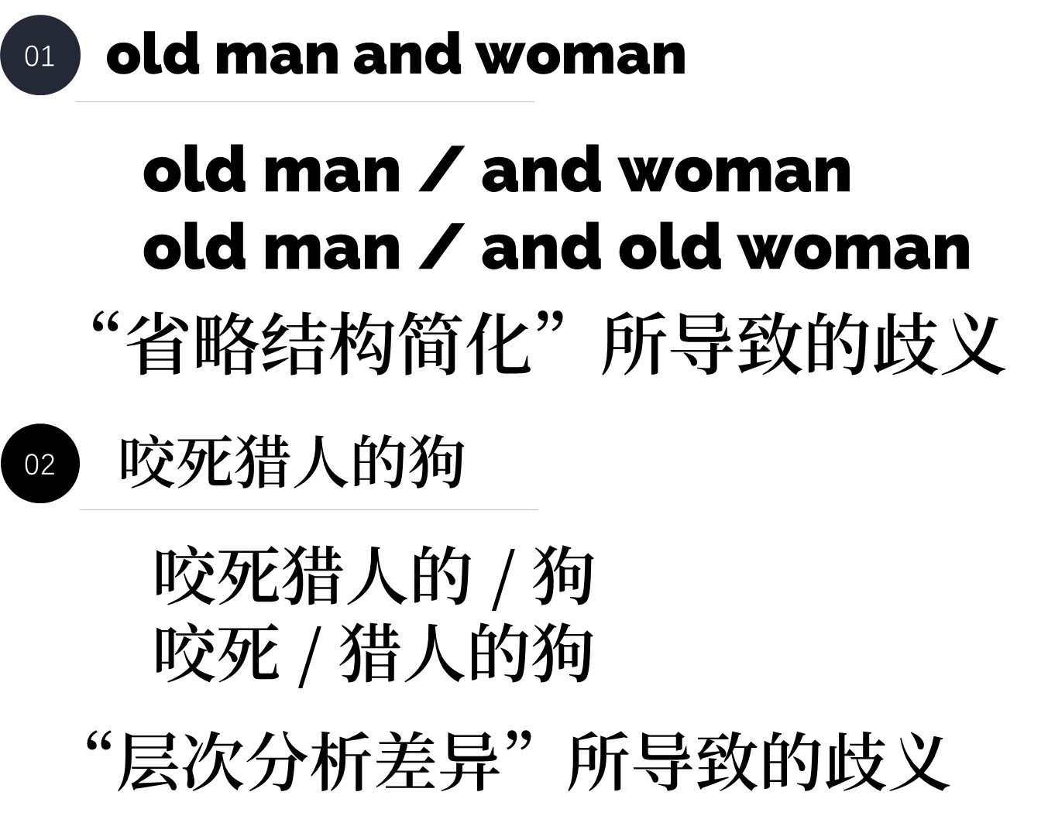

Slide 18



Slide 19
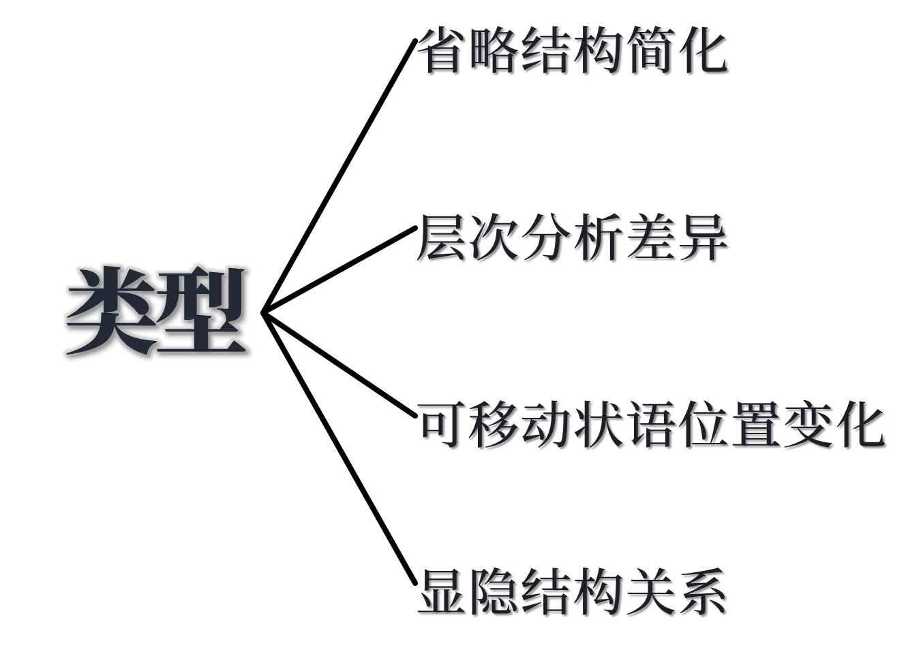

Slide 20
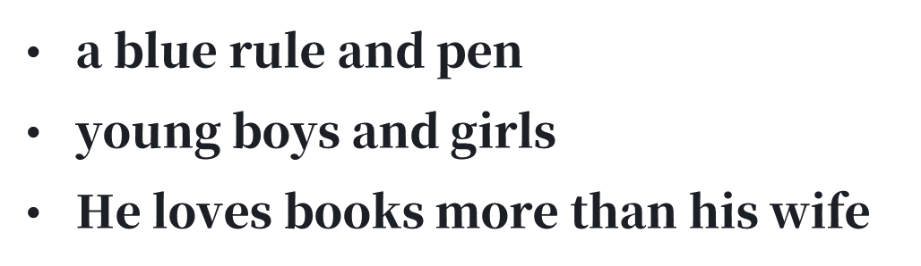

Slide 21
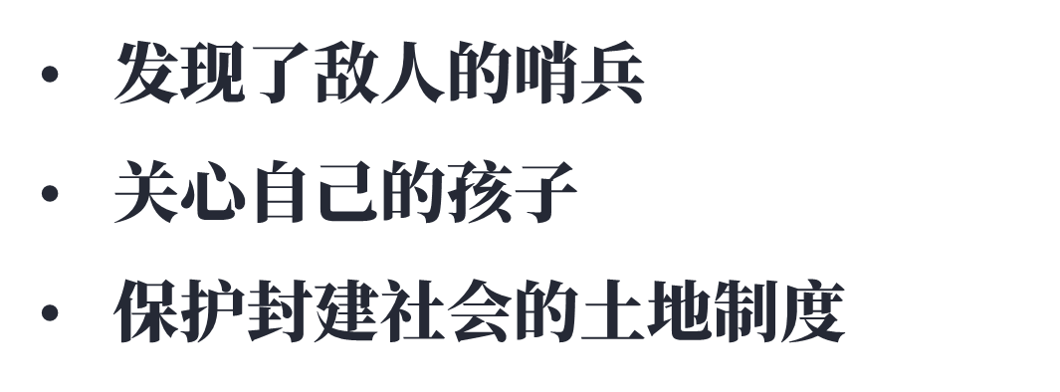

Slide 22
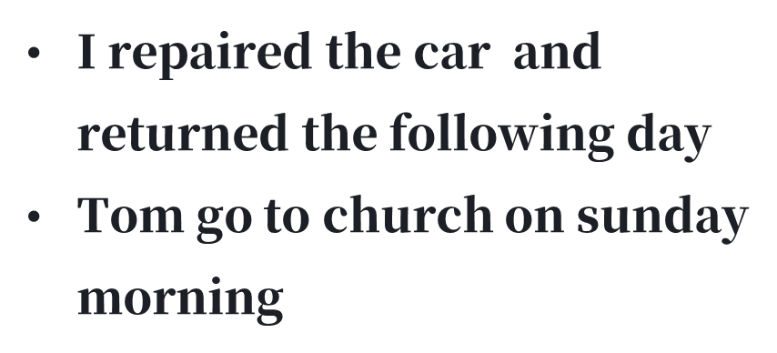

Slide 23
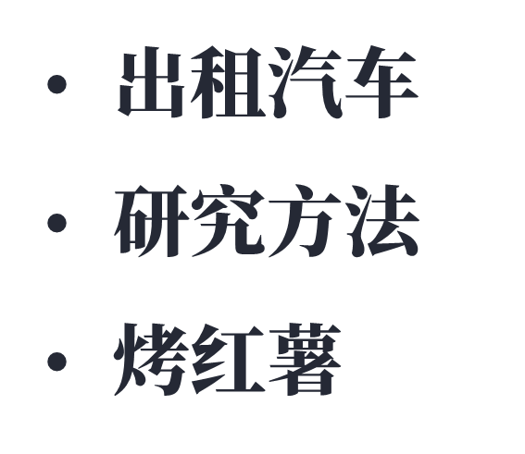

Slide 24


Slide 25
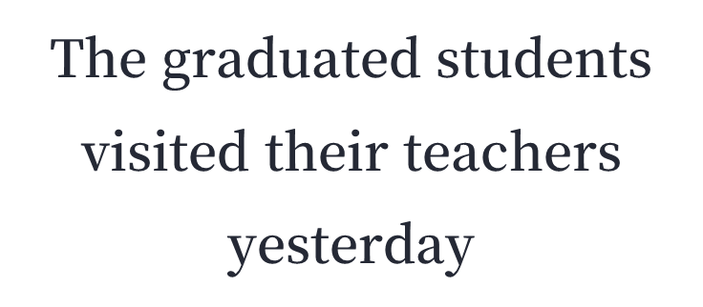
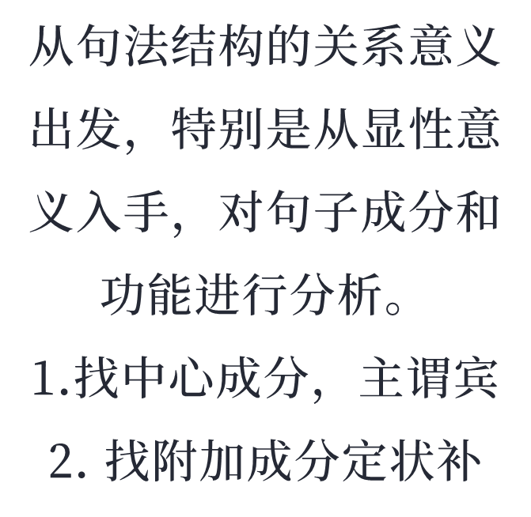
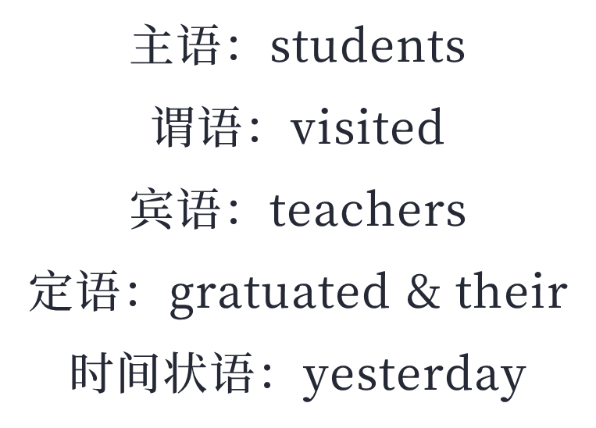
中心词分析法

Slide 26
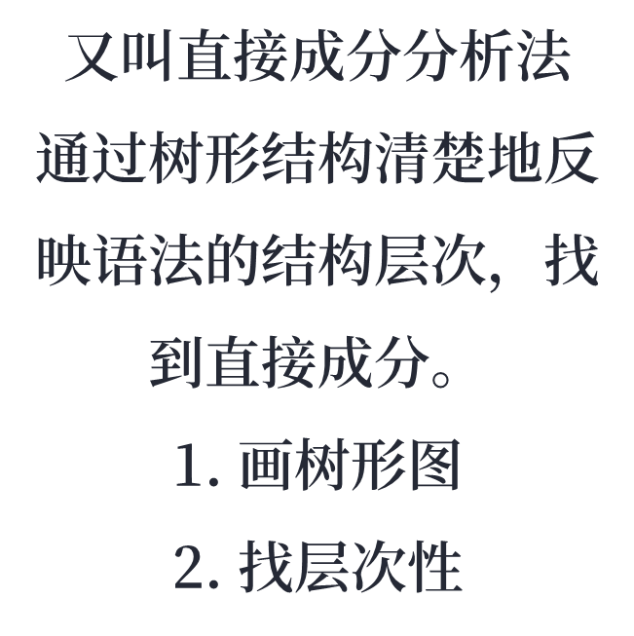
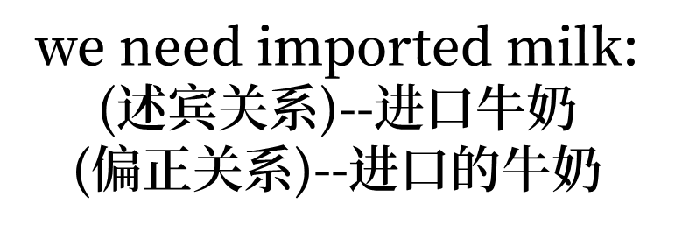
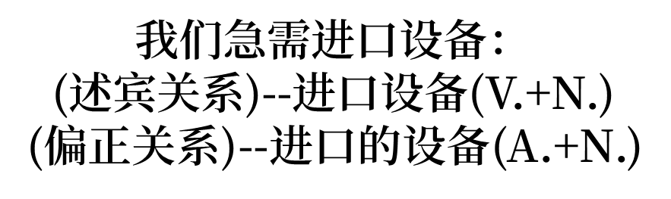
层次分析法

Slide 27
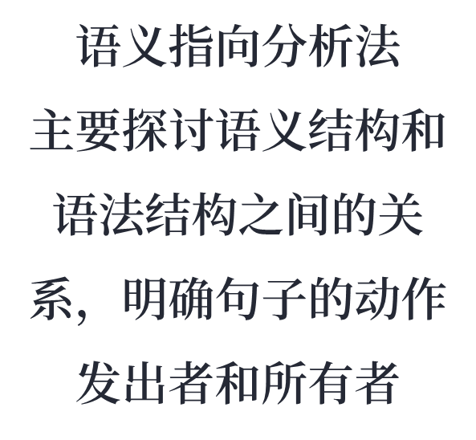
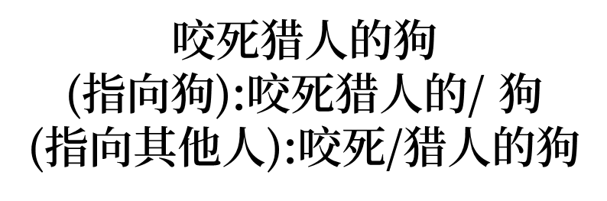

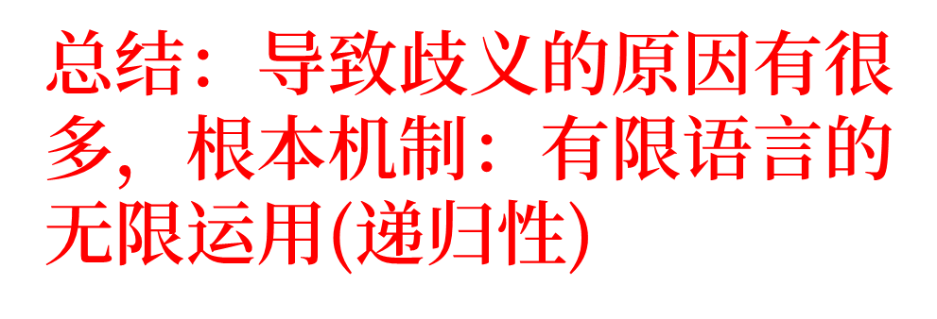
语义指向分析法

Slide 28




Slide 29
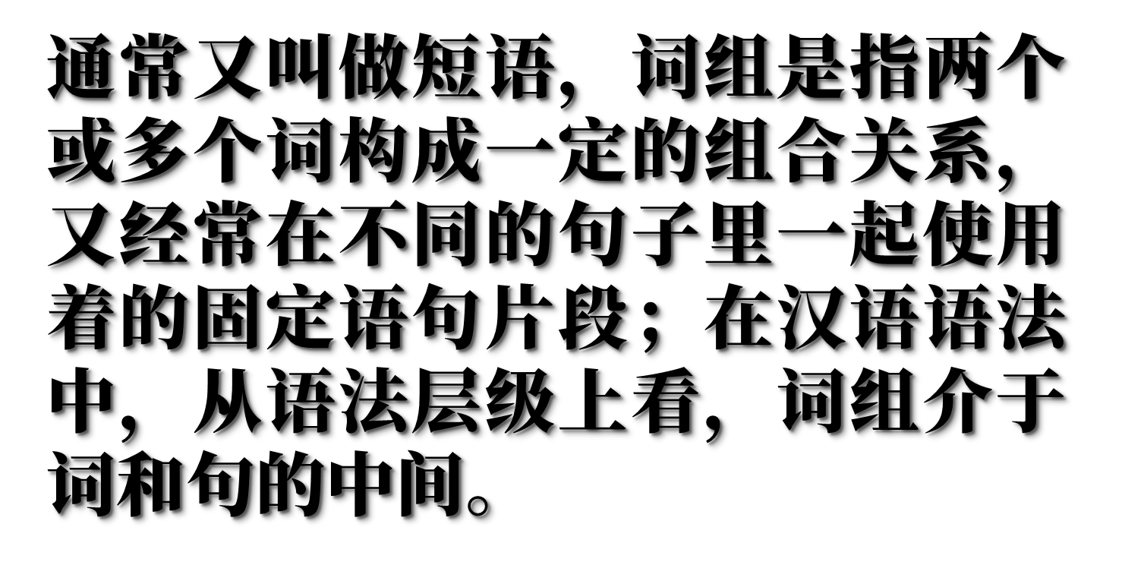

Slide 30




Slide 31
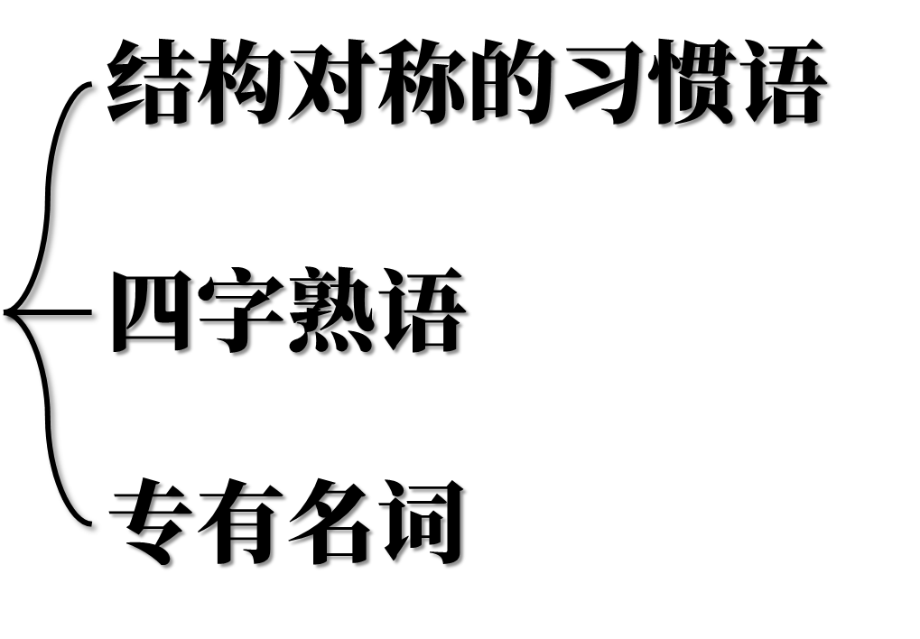

Slide 32






Slide 33
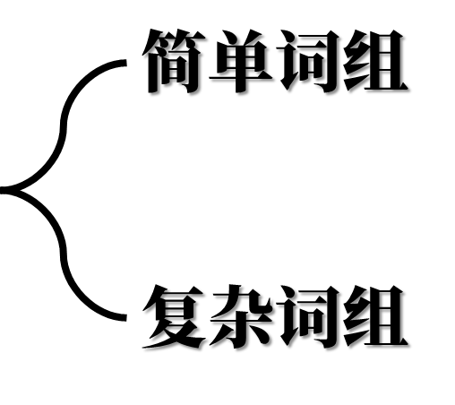


Slide 34


Slide 35
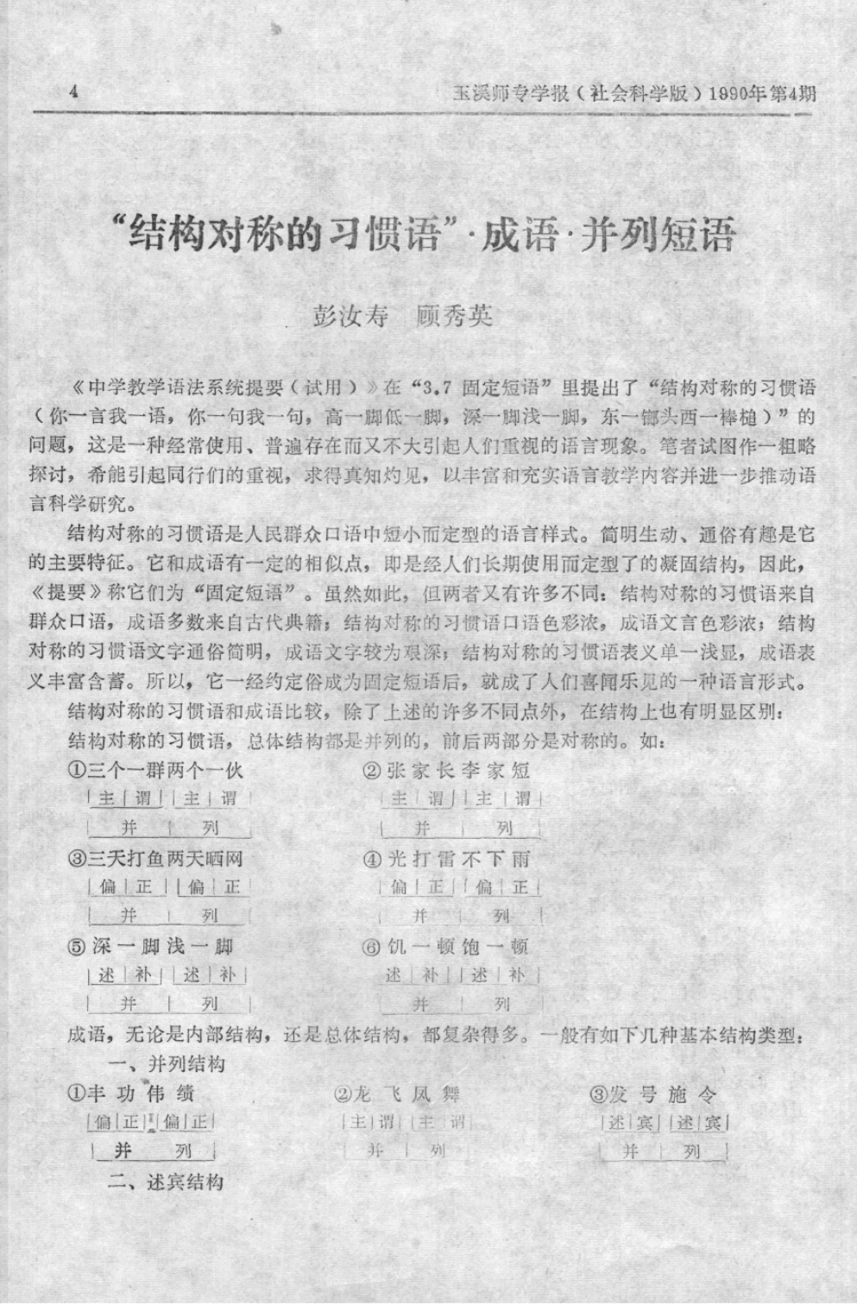
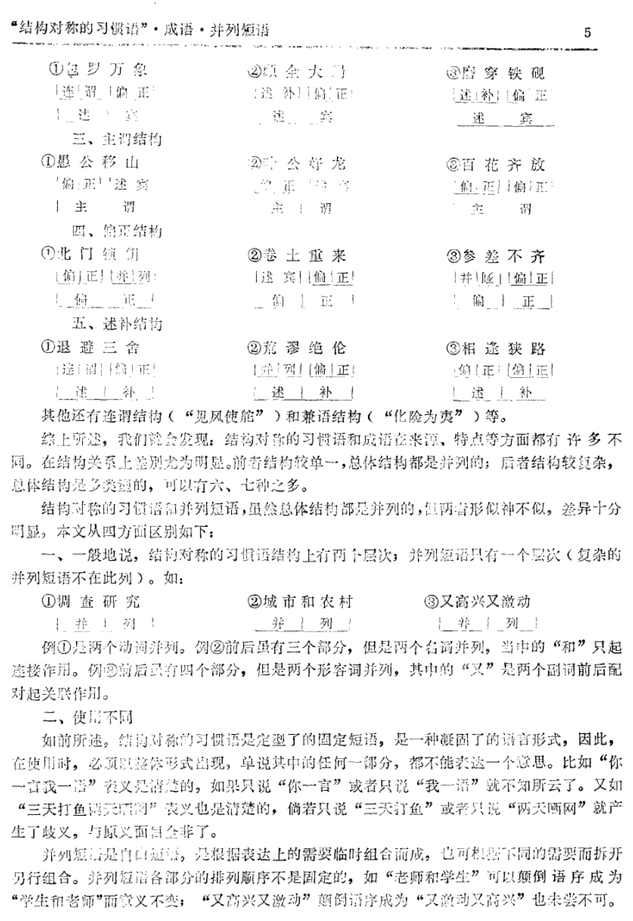

Slide 36
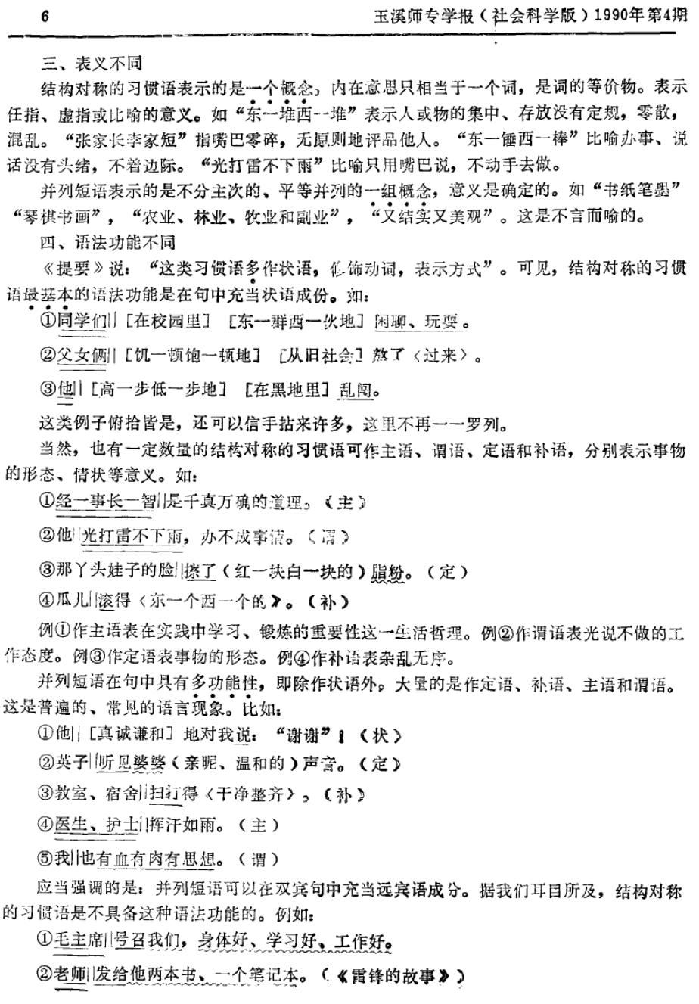
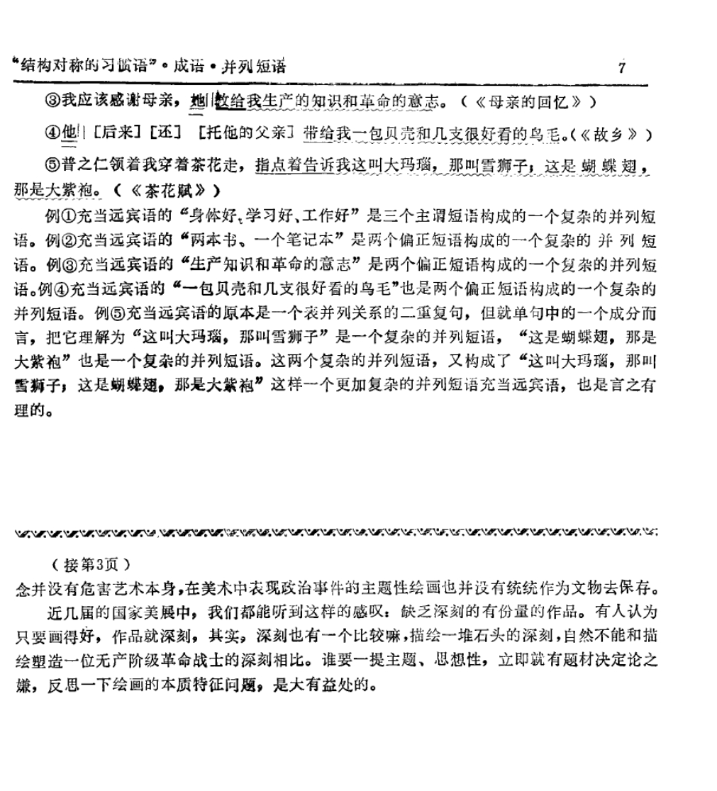

Slide 37
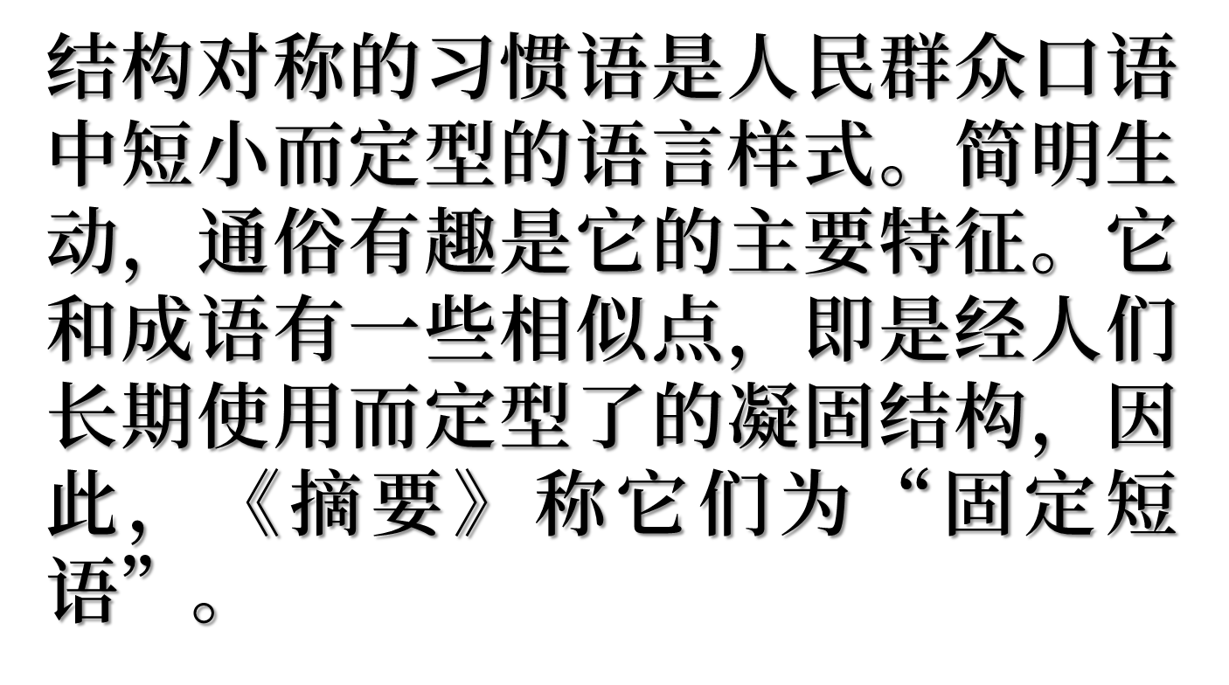

Slide 38






Slide 39

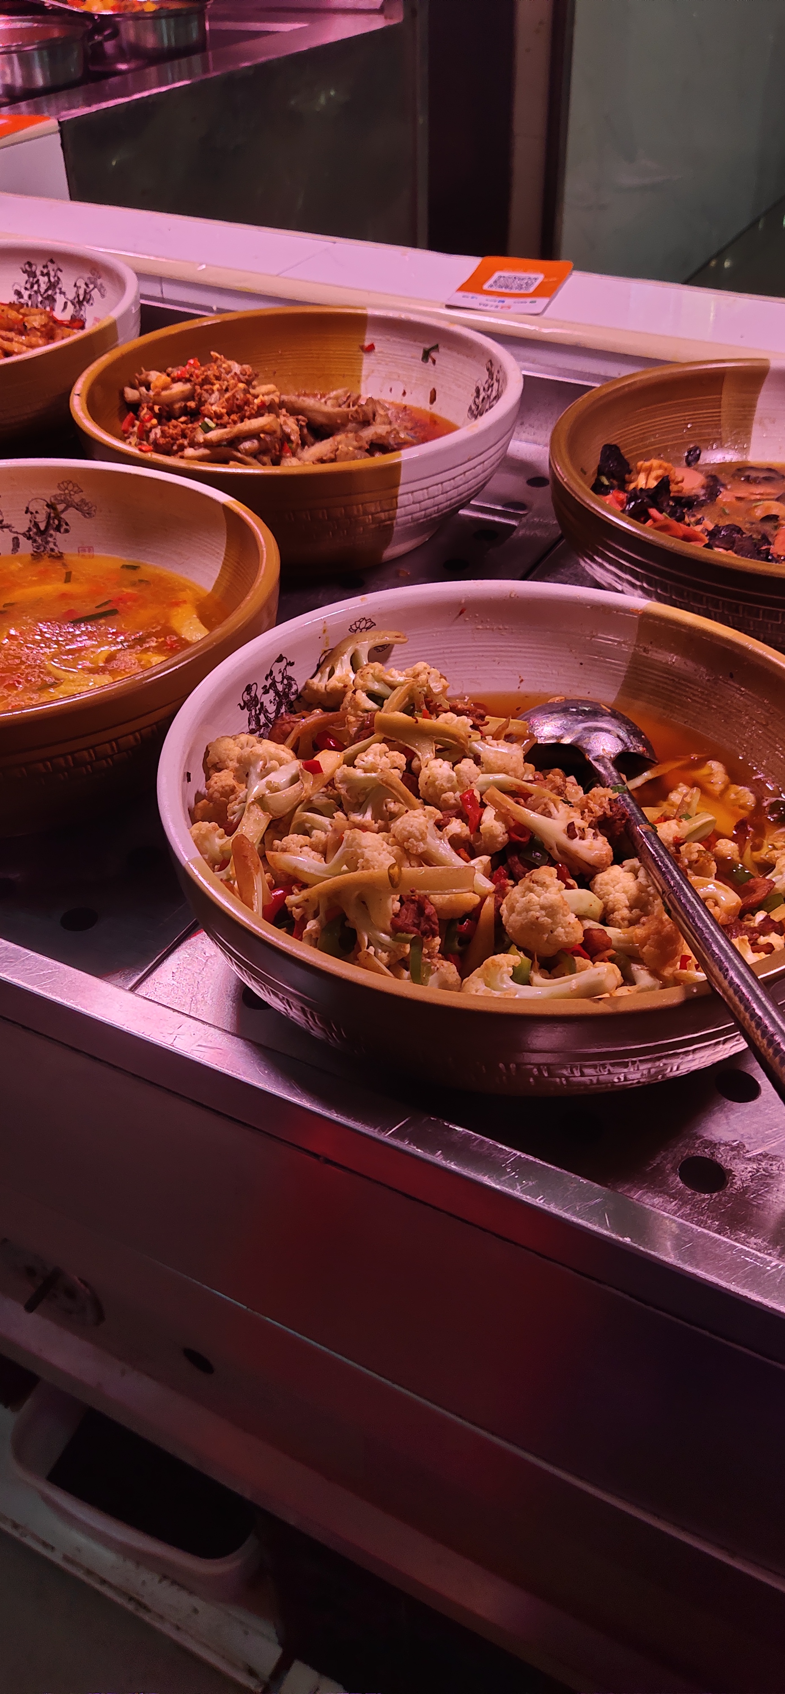
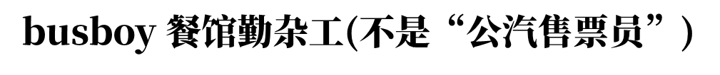

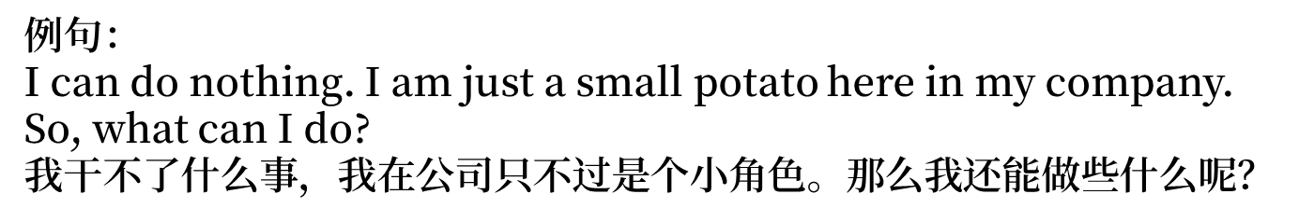

Slide 40

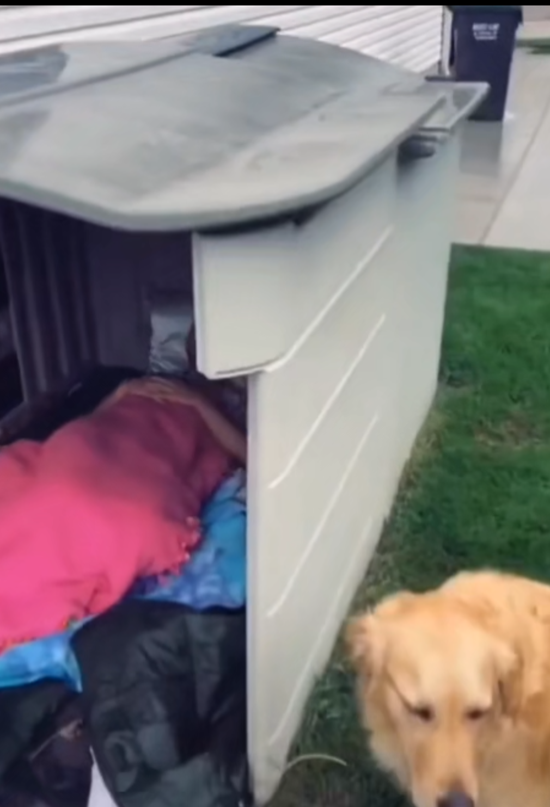


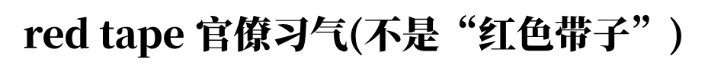
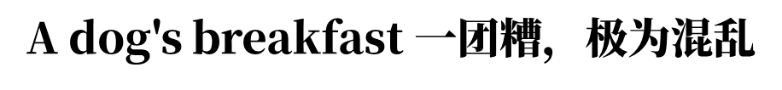
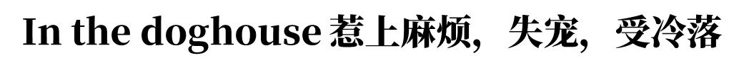

Slide 41






Tree Diagram
mqf

Slide 42


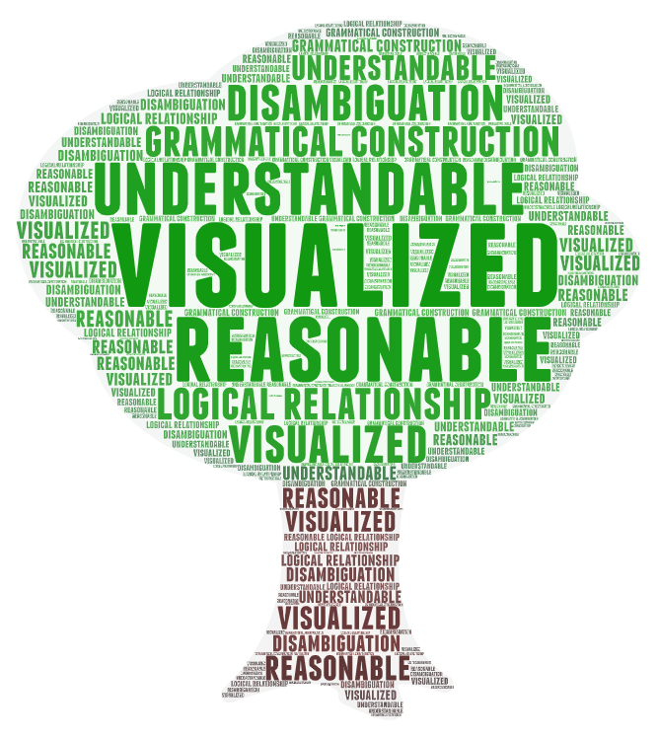
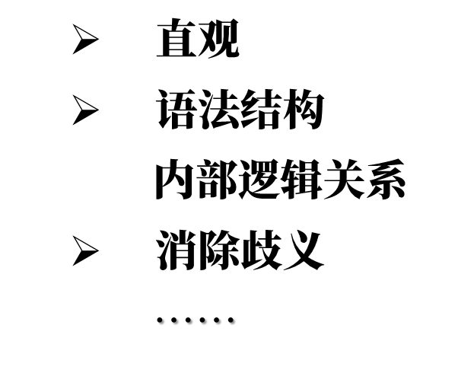


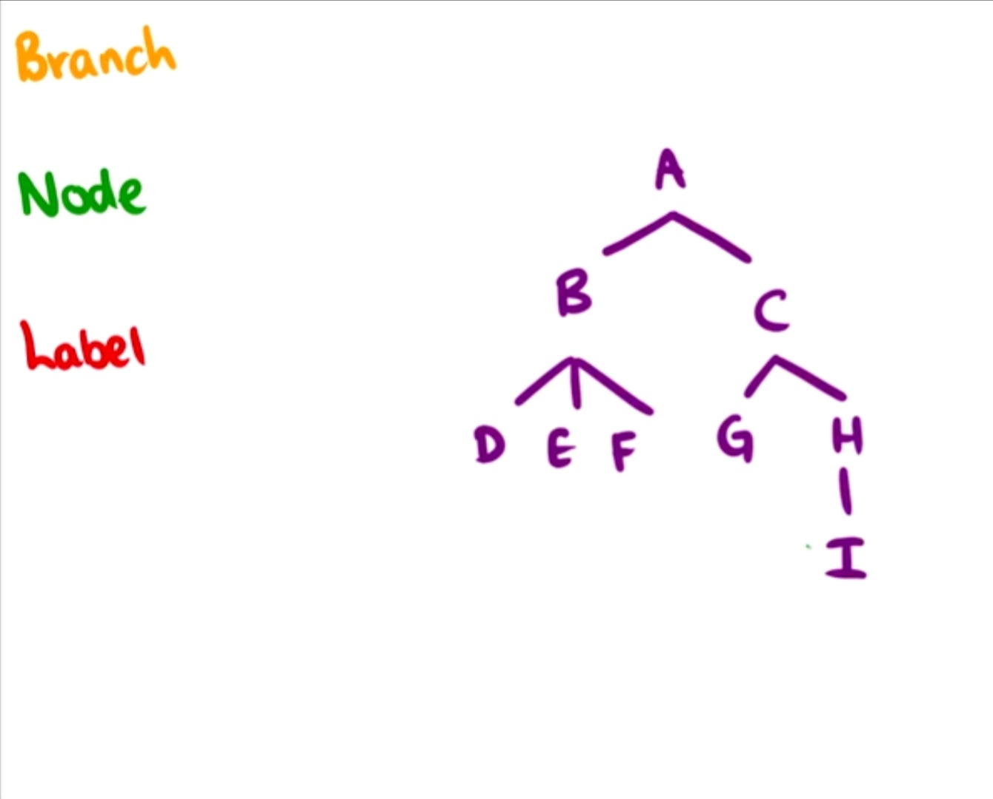





What & Why

Slide 43


How

Slide 44
Lexical Categories
Major lexical categories | Examples
Noun（N） | book, boy, love, sheep
Verb（V） | run, read, play
Adjective（A） | happy, tall, clear
Adverb（Adv） | fast, carefully, out, in
Preposition（P） | about, over, on
Minor lexical categories | Examples
Determiner（Det） | the, a, this, those, my
Degree words（Deg） | quite, very, more, so
Qualifier（Qual） | often, always, seldom, almost
Auxiliary（Aux） | must, should, can, might
Conjunction（Con） | and, but, or

Slide 45

Structure Rules

Slide 46

Examples （初级版）——简单句
S
NP
VP
Det
N
V
Adv
My knee went out.

Slide 47
Examples （初级版）——歧义句
S
NP
VP
Det
N
VP
PP
V
NP
P
NP
Det
N
Det
N
The woman saw the man with a telescope.

Slide 48
Examples （初级版）——歧义句
S
NP
VP
NP
Det
N
V
Det
NP
N
PP
P
NP
Det
N
The woman saw the man with a telescope.

Slide 49
Examples （初级版）——并列句
S
S
Con
S
NP
VP
NP
VP
V
Det
N
V
Adv
Det
N
Adv
The teacher came in and the students calmed down.

Slide 50
Examples （进阶版）——宾语从句
S
C（complementizer）补语化成分：that, if, whether
CP=C+S
NP
VP
V
CP
N
C
S
S
S
Con
NP
VP
NP
VP
Aux
VP
V
N
Aux
N
V
PP
P
NP
Det
N
Shelley said that winter will approach and spring will be around the corner.

Slide 51


Recommendation

